Slide 1
DIMOND BUSINESS IMPROVEMENT DISTRICT
Management Plan Review
February 2023

Slide 2
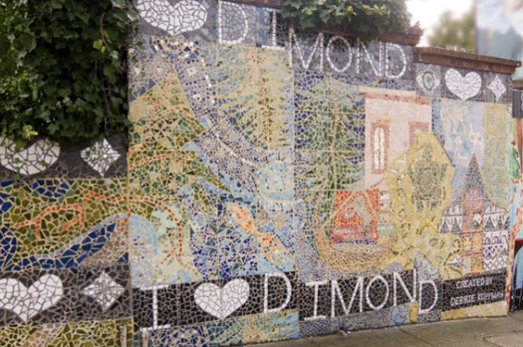
What Is A Business Improvement District?
A Business Improvement District (BID) is a public-private initiative that allows property owners within a defined area to pool resources and invest in enhanced services that support the area, including improvements in safety, maintenance and beautification, marketing and promotions and business development. The goal of a BID is to help businesses thrive and sustain a thriving neighborhood for businesses, workers, residents and visitors.
In Oakland, there are 10 operating BIDs, 1 tourism district and 5 neighborhoods in the process of forming districts. Combined, Oakland BIDs represent over 5,000 businesses and property owners and contribute ~$10m more in special services to Oakland’s commercial corridors.
Oakland BIDs:
Jack London Downtown
Uptown Lakeshore
Temescal Montclair
Chinatown Laurel
Rockridge Koreatown-Northgate (KONO)

Slide 3
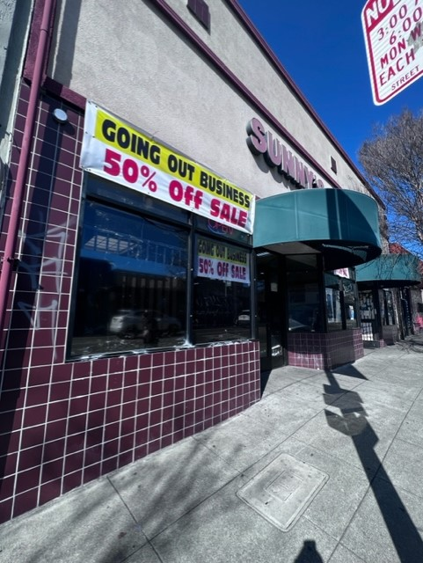
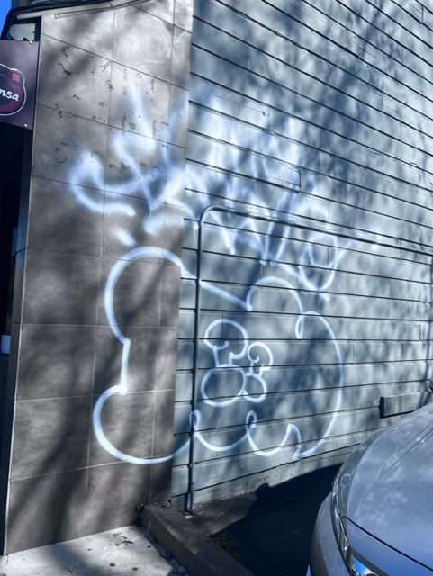
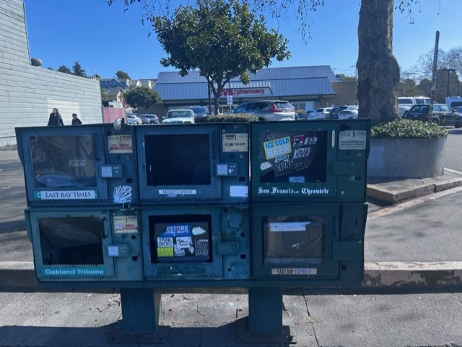
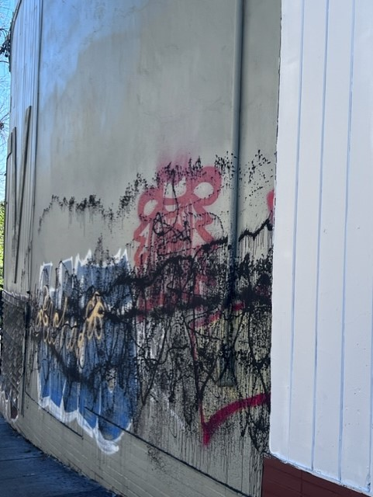
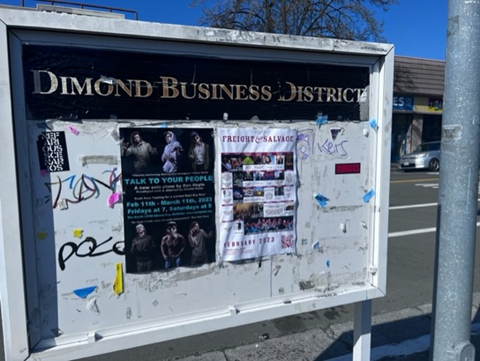
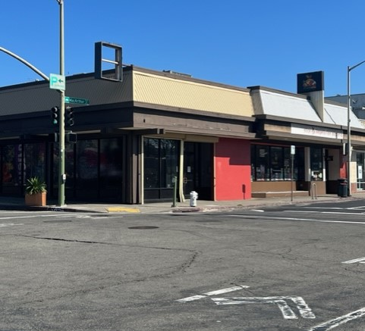
Why form a BID?
BID’s enhance public safety, support the unhoused, facilitate clean and beautiful streets and public spaces, remove graffiti and address illegal dumping, promote neighborhood businesses, reduce vacancy rates and drive foot traffic. The Dimond needs that kind of support!

Slide 4
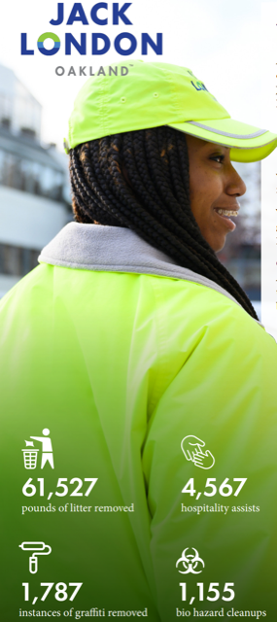
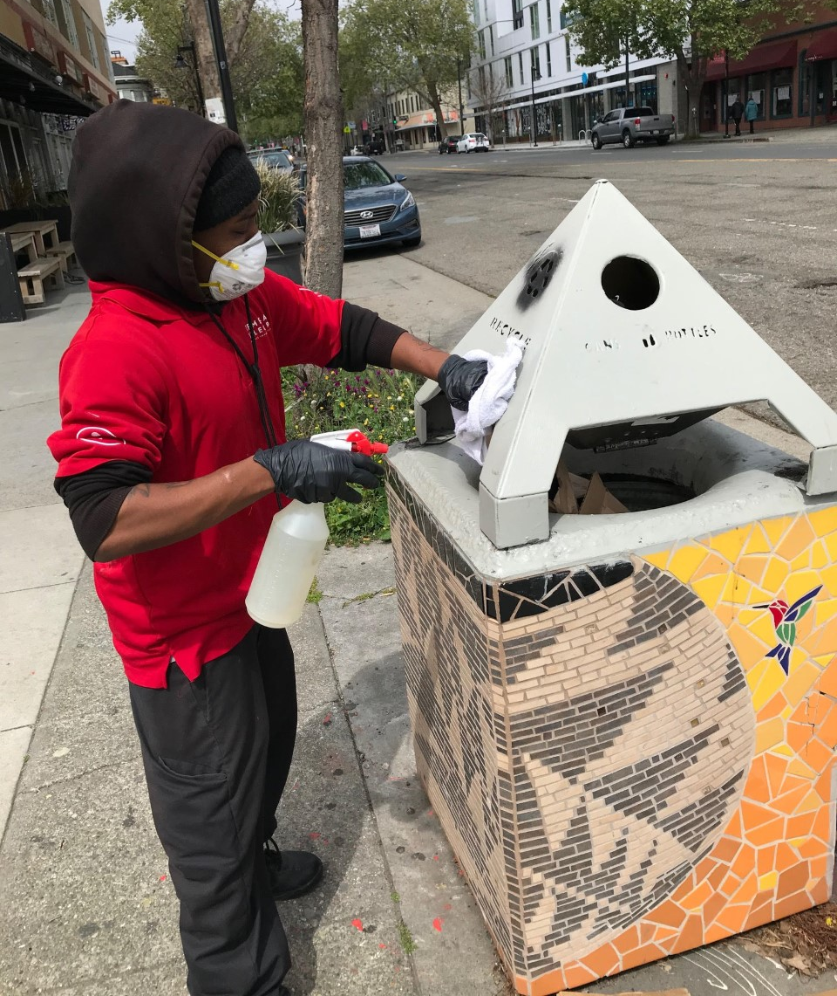
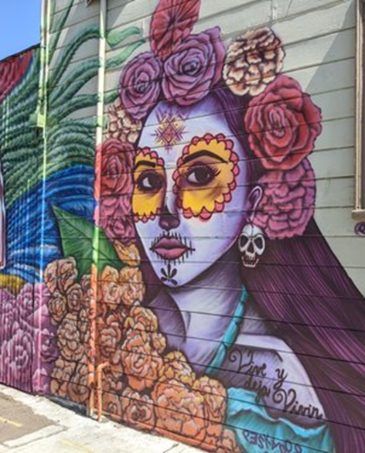
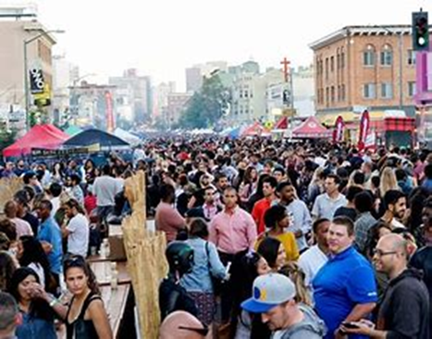
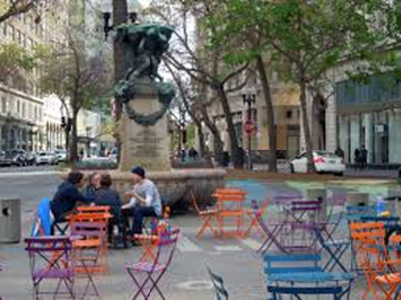
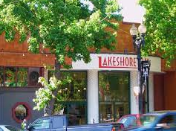
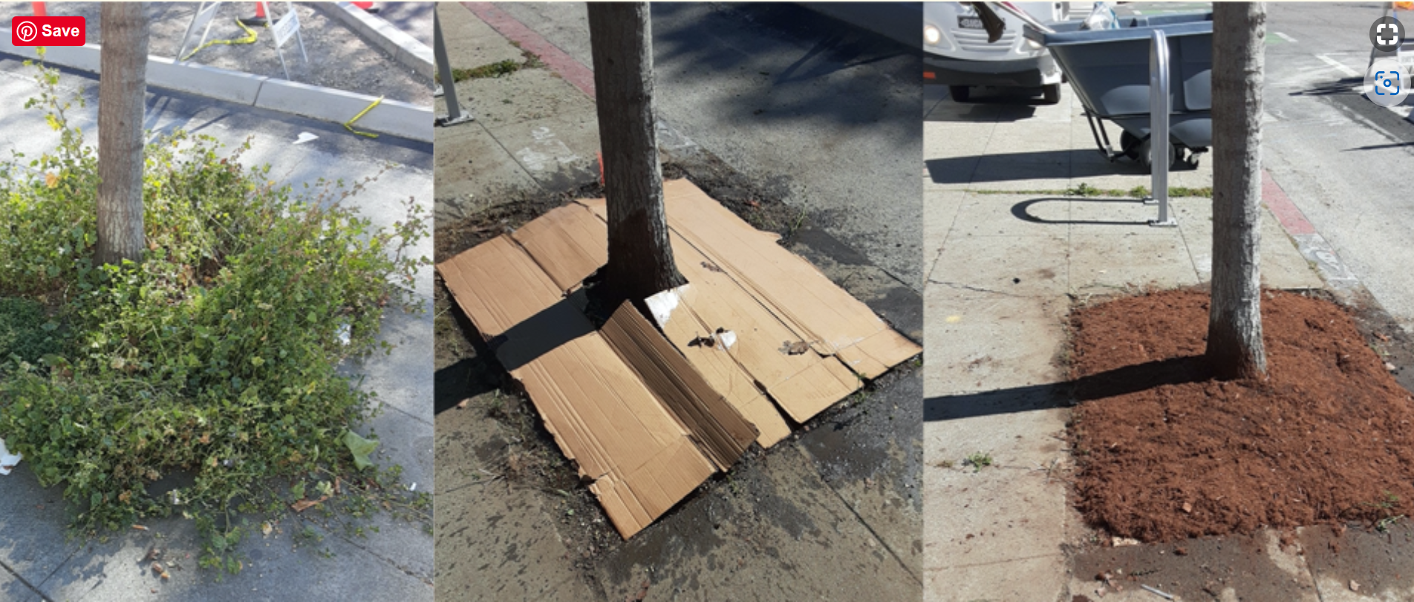
Oakland BIDs in Action

Slide 5
Business Improvement District Model:
Delivers essential services over and above what government provides
Concentrated efforts within an approved geographic boundary
Services paid for by a special property owner assessment
Management and service delivery from a separate organization
Organization governed by a Board that is comprised primarily of property owners
Both residential and commercial properties can be part of a BID

Slide 6
Benefits of a District
Improved Property Values
Reduced
Crime
Increased Spending
Increased Foot Traffic in District
Enhanced Physical Appearance
Unified Voice and Collective Clout

Slide 7
Process To Create the Dimond BID:
Engage Property & Business Owners
Feasibility of District
Boundaries
Service Priorities: Focus Groups, Surveys, Phone calls
Draft Work Plan
Budget
Assessment Methodology
Baseline Services
Feedback on Work Plan
Petition
Council Action
Property Tax Collection

Slide 8
Proposed Dimond BID Service Plan

Slide 9
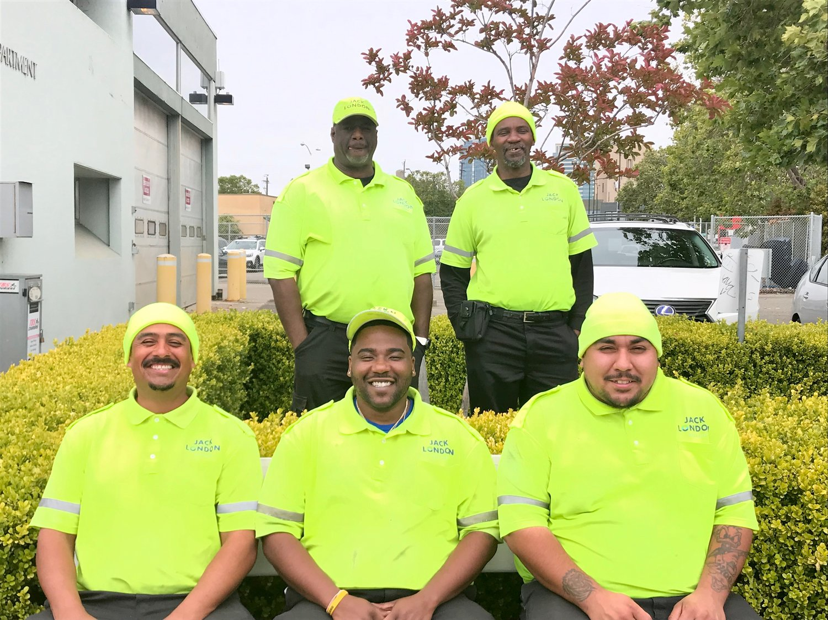
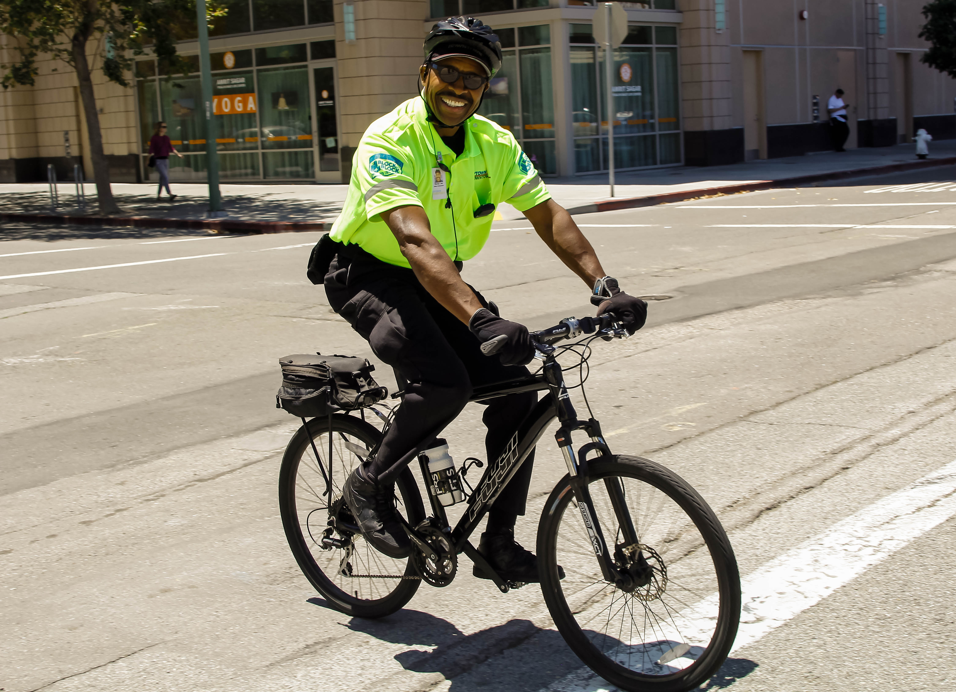
Safe and Welcoming
Ambassadors:
Support property owners and businesses in overall crime prevention efforts above what the City of Oakland provides
Deter activities like vandalism, graffiti, illegal dumping, trespassing, etc.
Act as “eyes and ears” and coordinating with law enforcement, when appropriate
Perform wellness checks on unhoused individuals
Provide concierge-level service to customers, residents, business owners and employees
This program will be based on successful models in similar-sized districts, with similar-sized budgets
Jack London District Ambassadors
Downtown Oakland Ambassador

Slide 10
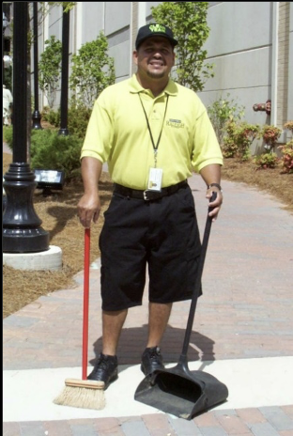
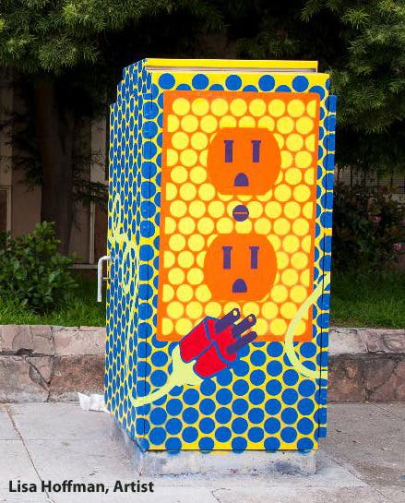
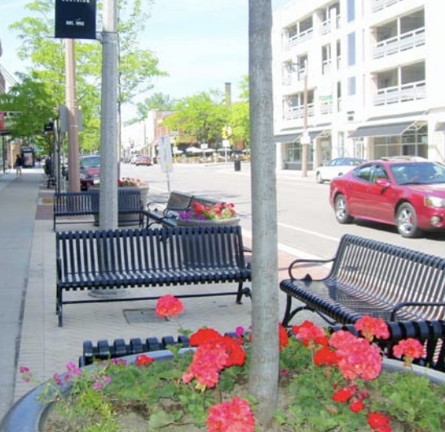
Maintenance
Remove litter, trash and graffiti
Sweep, scrub and pressure wash sidewalks and public spaces
Install and maintain common area landscaping
Provide enhanced cleaning services while focusing on customer service
Jack London District Ambassadors
Beautification
Install and maintain public space amenities such as streetscape furniture, bike racks and information kiosks
Consider other best practices such as tree lighting, wayfinding signage and banners
Support placemaking activities and public art opportunities
Downtown Milwaukee, MN

Slide 11
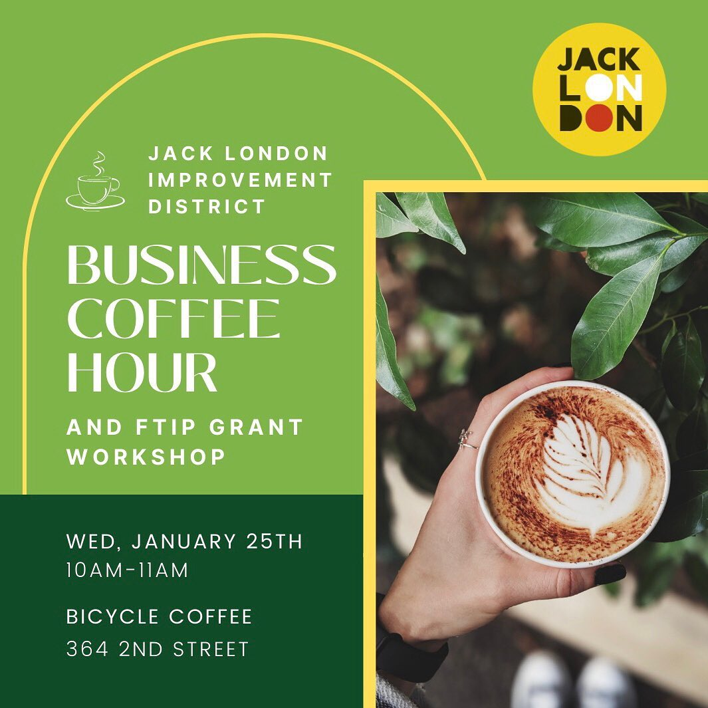
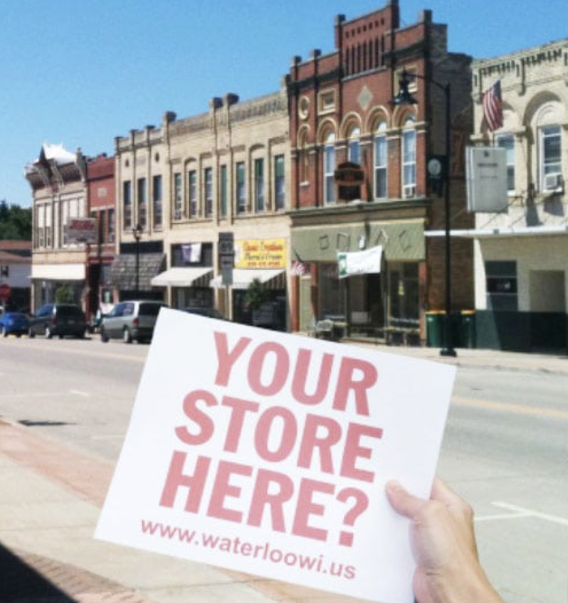
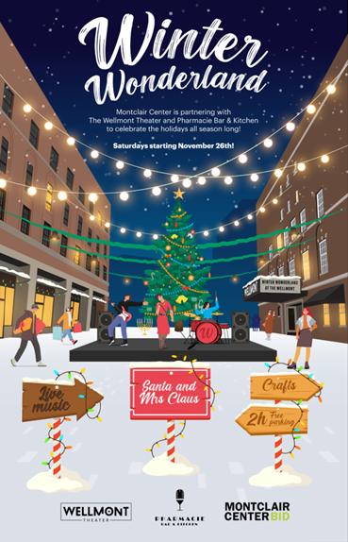
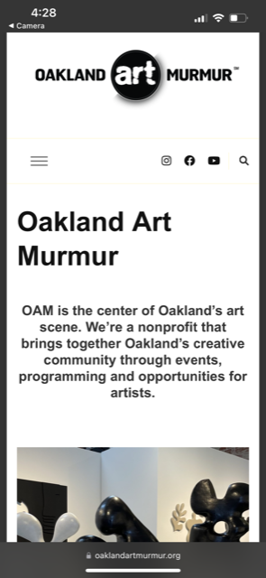
Business Development
Assist property owners in recruiting and retaining businesses
Assist business and property owners navigate City processes
Support marketing real estate investment and redevelopment opportunities
Marketing and Promotions
Develop a complete marketing and branding program consistent with the District’s character
Create new collateral, website, social media to engage residents, entice customers and promote businesses located in the District

Slide 12
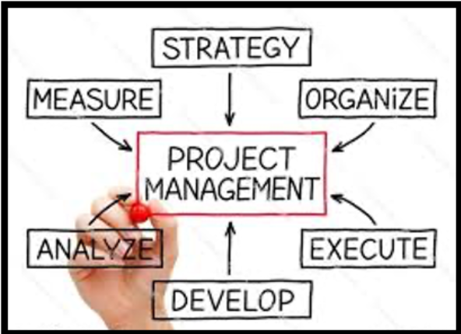
Management / Advocacy
Coordinate desired programs and manage district initiatives day-to-day
Clean, Safe, Beautiful and Welcoming
Marketing
District Management and Advocacy
Facilitate and staff board and committee meetings
Serve as a representative of the business community with the city
Advocate for policies and resources that further the interests of the neighborhood
Business Development
Communicate with, and serve as a resource for, local businesses

Slide 13
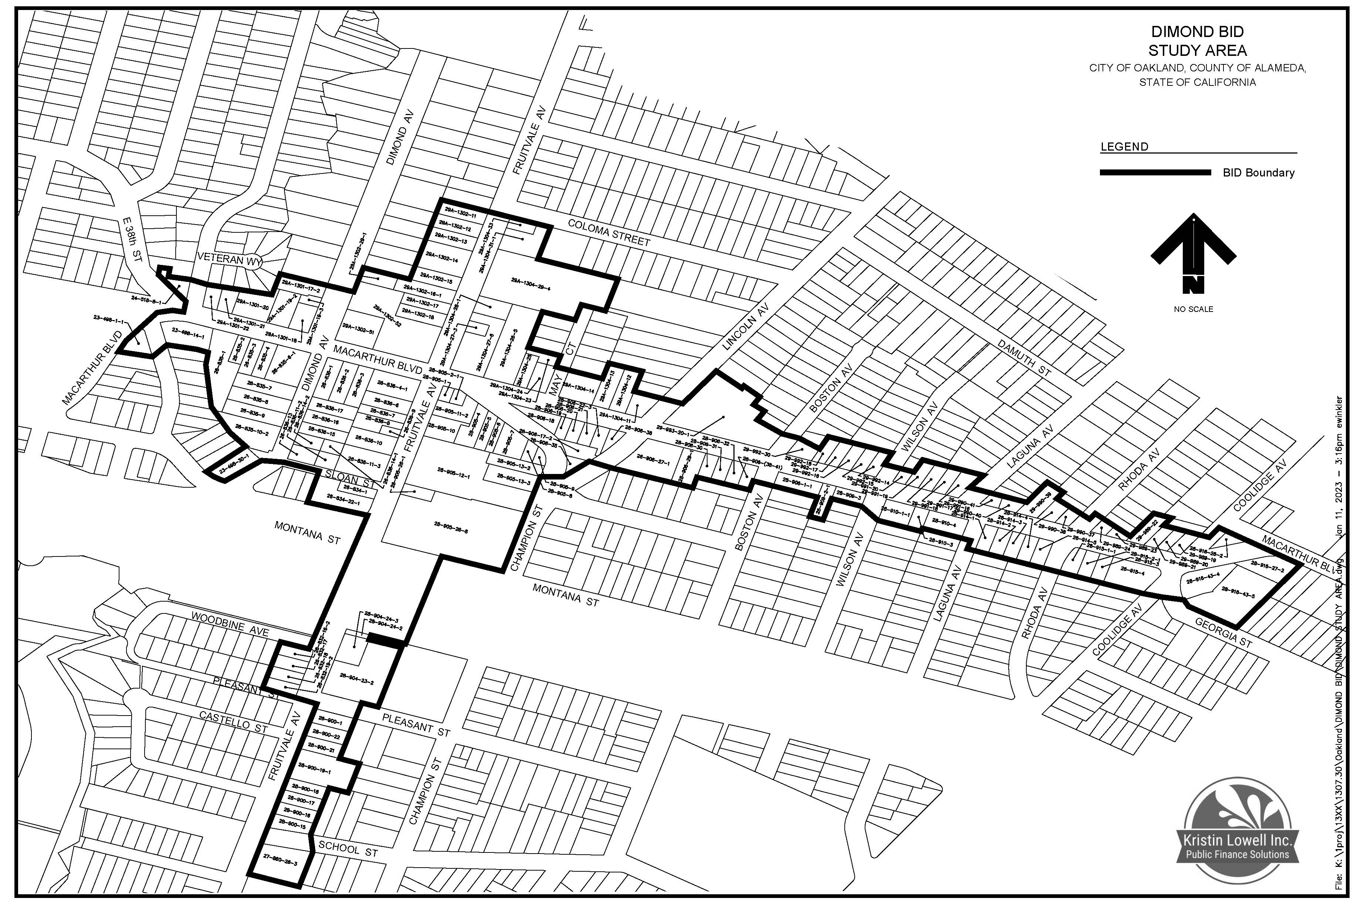
Boundary

Slide 14
Budget
Total DBID budget for its first year of operations is $280,000, as follows:
EXPENDITURES | TOTAL BUDGET | % of Budget
Clean, Safe, Beautiful and Welcoming Services | $160,000 | 57.14%
Dimond Business Development & Vitality | $40,000 | 14.29%
District Management & Advocacy | $70,000 | 25.00%
District Fees & Reserves | $10,000 | 3.57%
Total Expenditures | $280,000 | 100.00%
REVENUES
Assessment Revenues | $274,400 | 98.00%
Other Revenues | $5,600 | 2.00%
Total Revenues | $280,000 | 100.00%

Slide 15
Assessments
All assessments are based upon an allocation of program costs and a calculation of lot + building square footage plus linear street frontage. Estimated annual maximum assessment rates for the first year of the DBID are as follows:
Land Use | Per Lot+Bldg SgFt | Per Linear Foot
Commercial | $0.07808 | $11.23718
Residential 4+ units | $0.07808 | $11.23718
Government | $0.06460 | $9.29152
Non-Profit | $0.06460 | $9.29152
Residential 1-3 units | $0.06460 | $9.29152

Slide 16
Assessment - Example
The initial annual parcel assessment for a COMMERCIAL parcel with 5,000 lot square feet + 5,000 building square feet 50 linear feet
Lot + Bldg SF x the assessment rate (10,000 x $0.07808) | $780.80
Linear frontage x the assessment rate (50 x $11.23718) | $561.86
Initial Annual Parcel Assessment |  | $1,342.66

Slide 17
Assessment - Example
The initial annual parcel assessment for RESIDENTIAL 1-3 units with 5,000 lot square feet + 2,500 building square feet 50 linear feet
Lot + Bldg SF x the assessment rate (7,500 x $0.06460) | $484.50
Linear frontage x the assessment rate (50 x $9.29152) | $464.58
Initial Annual Parcel Assessment |  | $949.08

Slide 18
Formation Timeline
MONTH | ACTIVITY
February | Stakeholder Workshops Submit Management Plan to City
March - April | Petition Drive
May 16th | City Council adopts Resolution of Intention and mails ballots
May - July | Ballot campaign
July 18th | City Council holds public hearing and tabulates ballots

